Slide 1

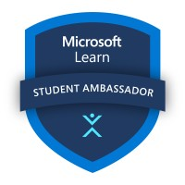
My MLSA Internship: Full Stack Development Journey
My journey began as a curious student eager to learn the fundamentals of full-stack development. The MLSA internship offered the perfect opportunity to dive deep into the world of web development, equipping me with the skills and knowledge to build robust and engaging web applications.
by Piyush Raj

Slide 2


Introduction: Piyush Raj
. Hello! I’m Piyush Raj, currently a 3rd-year student at the KIET Group of Institutions. Recently, I had the incredible opportunity to complete an internship as a Microsoft Learn Student Ambassador (MLSA), which expanded my knowledge in various tech domains and community-building and technical education.
1
Building Real-World Projects
2
Team Collaboration
My goal was to acquire practical skills by building real-world projects, gaining hands-on experience and applying theoretical knowledge.
I was eager to collaborate with experienced professionals, learn from their expertise, and contribute to a team environment.

Slide 3
Learning the MERN Stack: Challenges and Triumphs
My internship focused on the MERN stack - MongoDB, Express.js, React, and Node.js. I tackled each component individually, understanding their functionalities and exploring their intricacies.
1
2
3
4
MongoDB Database
Express.js Framework
React.js Library
Node.js Runtime Environment
Learning to design, query, and manage databases with MongoDB was a key challenge. I explored various database concepts like schema design and indexing strategies.
I delved into the world of React, learning to build dynamic user interfaces using components, state management, and lifecycle methods.
I learned to build RESTful APIs using the Express.js framework, mastering concepts like routing, middleware, and error handling.
I explored the Node.js environment, understanding its role in server-side development and building backend applications.

Slide 4
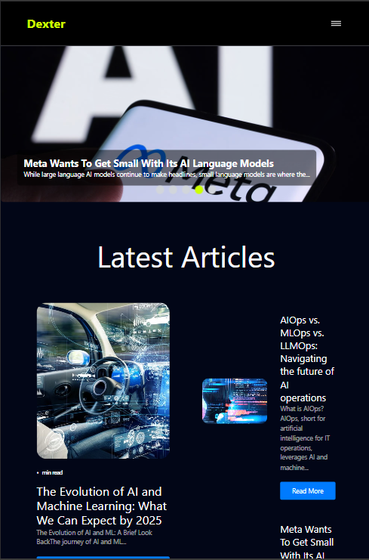
Building My First Full Stack Web Application: Dexter Blog App
Dexter provides a dynamic platform for users to share, explore, and interact with blog content. Designed to streamline content creation and browsing, the application allows users to create, edit, and delete blog posts se
amlessly. It also features user authentication, enabling personalized experiences and secure access to blog data.
Project Planning
Frontend Development
The process started with meticulous planning, including defining project scope, designing database schema, and outlining the user interface.
I implemented the frontend using React, building interactive components and integrating them with the backend API.
Backend Development
I developed the backend using Node.js and Google Firebase creating APIs to handle data requests and responses from the frontend.
Live link of Project:-https://dexter-6b4f.vercel.app/

Slide 5
Collaborating With Cross-Functional Teams
The MLSA internship provided opportunities to collaborate with cross-functional teams, including designers, product managers, and other developers. This experience fostered teamwork, communication, and shared learning.
Team Dynamics
Communication Skills
Shared Learning
Working with diverse team members brought different perspectives and expertise, enhancing the project's success.
I honed my communication skills through effective collaboration, active listening, and clear articulation of ideas.
Learning from experienced professionals and sharing knowledge with team members created a collaborative environment for growth.

Slide 6
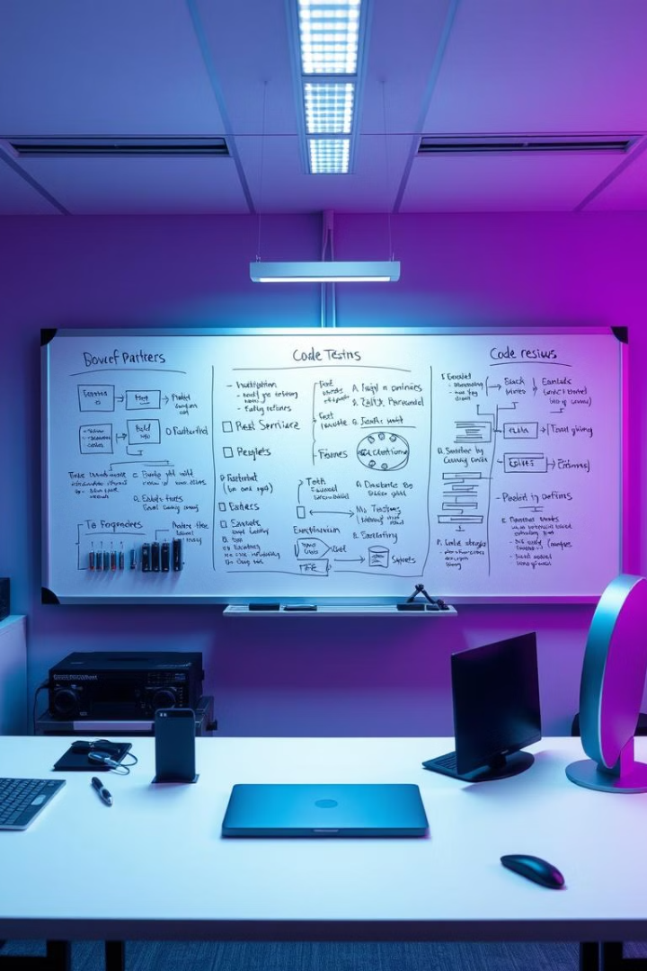
Implementing Best Practices in Software Development
Throughout the internship, I was exposed to industry best practices in software development. This included learning about design patterns, code review processes, testing methodologies, and version control systems.
Design Patterns
Understanding common solutions to recurring problems in software design.
Code Reviews
Collaborative process for improving code quality, identifying potential issues, and ensuring code consistency.
Testing Methodologies
Implementing comprehensive testing strategies to ensure the application's stability, functionality, and performance.
Version Control Systems
Utilizing version control systems like Git to track changes, manage code branches, and collaborate effectively on projects.

Slide 7





Expanding My Skills Through the MLSA Program
The MLSA program offered various resources and opportunities to expand my skillset beyond the core MERN stack. I delved into new technologies, frameworks, and concepts, broadening my knowledge and increasing my adaptability.
Cloud Computing
Cybersecurity
Learning to deploy and manage applications in the cloud using platforms like AWS and Azure.
Exploring concepts of security best practices and implementing measures to protect applications and data.
NoSQL Databases
Data Analytics
Expanding my database knowledge by learning about other NoSQL databases like Cassandra and Redis.
Exploring the intersection of data analytics with web development and utilizing data visualization tools.

